Slide 1
ELECTRIC MOTOR
Introduction
Types of Electric Motors
Working Principle
Applications of Electric Motors
Advantages of Electric Motors
Conclusion

Slide 2
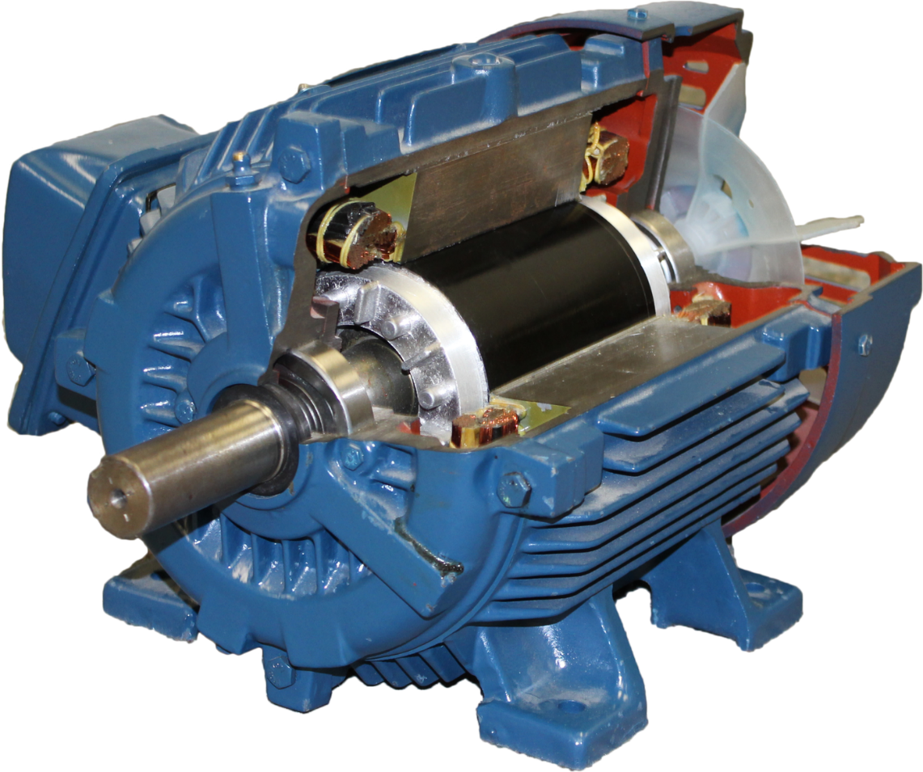
Introduction
Electric motors are devices that convert electrical energy into mechanical energy.
They are used in a wide range of applications, from household appliances to industrial machinery.

Slide 3
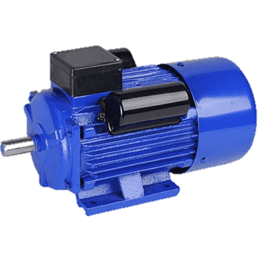
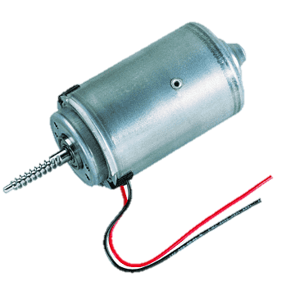
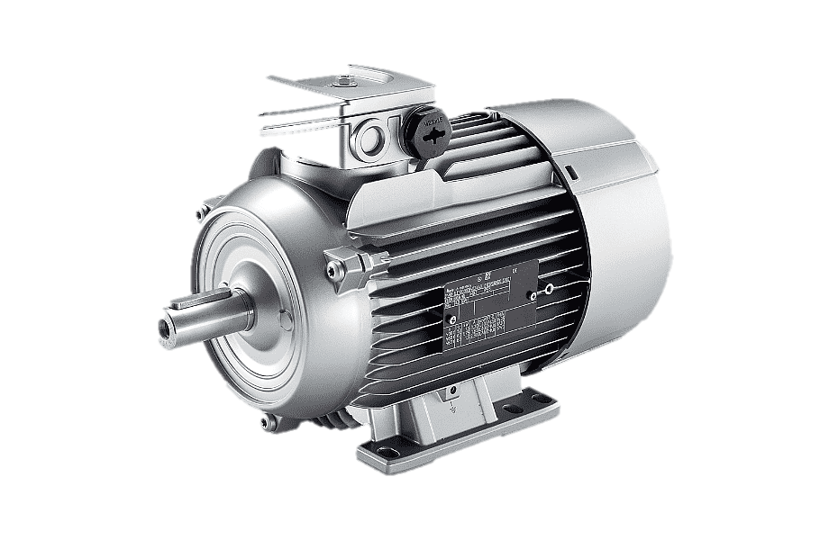
Types of Electric Motors
AC Motors: These run on alternating current (AC) and are commonly used in fans, pumps, and household appliances.
DC Motors: These operate on direct current (DC) and are used in electric vehicles, toys, and small machines.
Universal Motors: Can operate on both AC and DC, commonly found in tools like blenders and vacuum cleaners.

Slide 4
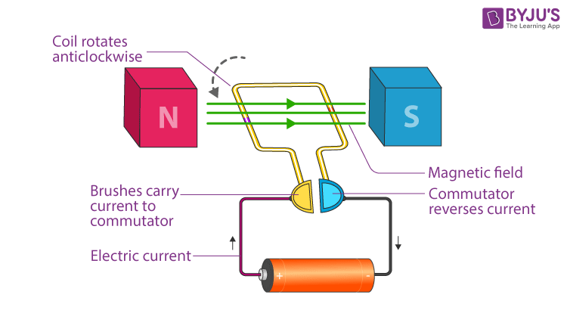
Working Principle
Electric motors work based on the interaction between magnetic fields and electric currents.
The basic components include a stator (stationary part) and a rotor (moving part), which interact to produce motion.

